Slide 1
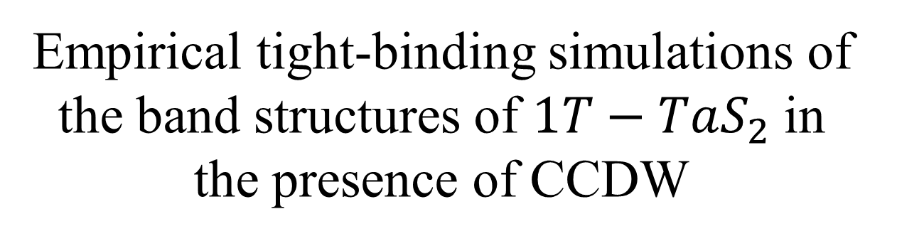
Empirical tight-binding simulations of the band structures of $1T−TaS_{2}$ in the presence of CCDW
汪 士
2019年1月9日
Notes:
各位老师同学大家上午好,今天在这里给大家介绍几个据称可以用来描述或者说拟合处于CCDW 相的1T-TaS2这种材料的性质的紧束缚模型, 至于CCDW这个缩写究竟是什么意思,我后面会加以说明

Slide 2
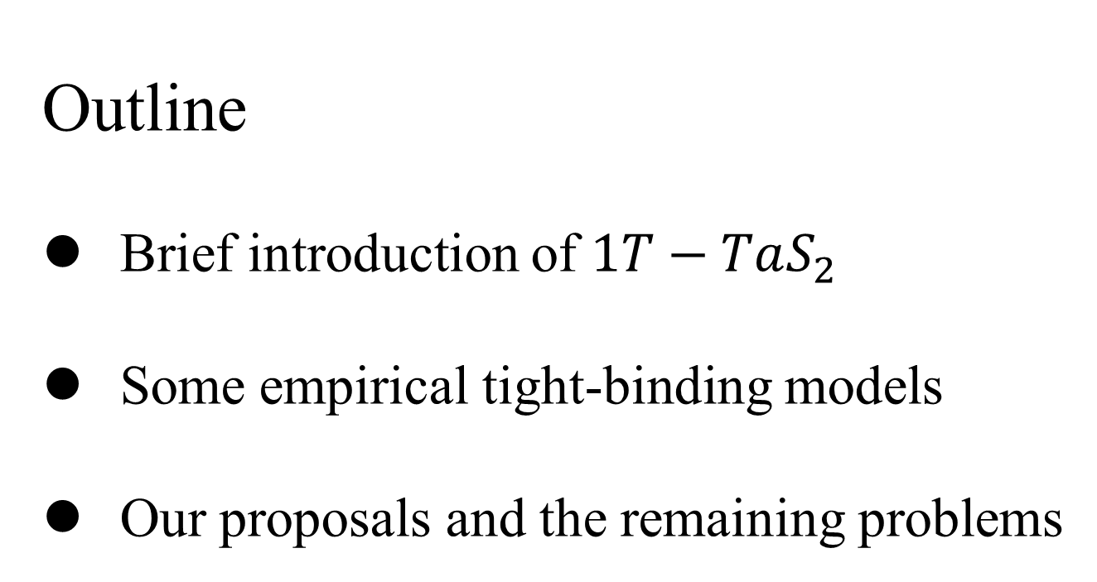
Outline
Brief introduction of $1T−TaS_{2}$
Some empirical tight-binding models
Our proposals and the remaining problems
Notes:
今天的报告分为三布冯,首先是关于1T-TaS2这种材料基本信息的一个介绍,主要包括材料的晶体结构,相图以及CDW, Commensurate, Imcommensurate等概念的解释
第二部分介绍几个别人已经提出来的紧束缚模型以及其背后的考量
最后一部分是我们关于这个问题提出的一些假设,以及目前面对的一些问题

Slide 3
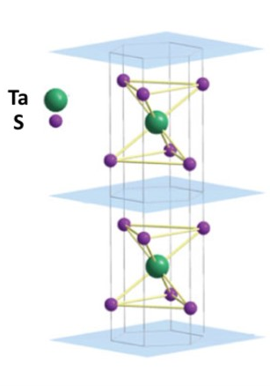
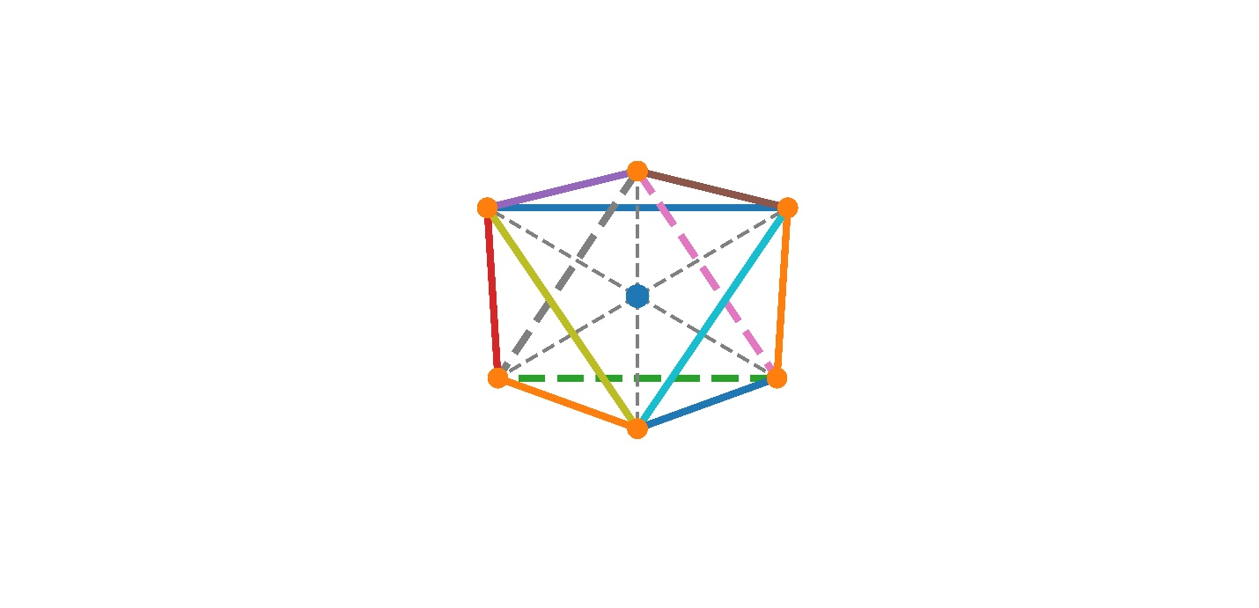
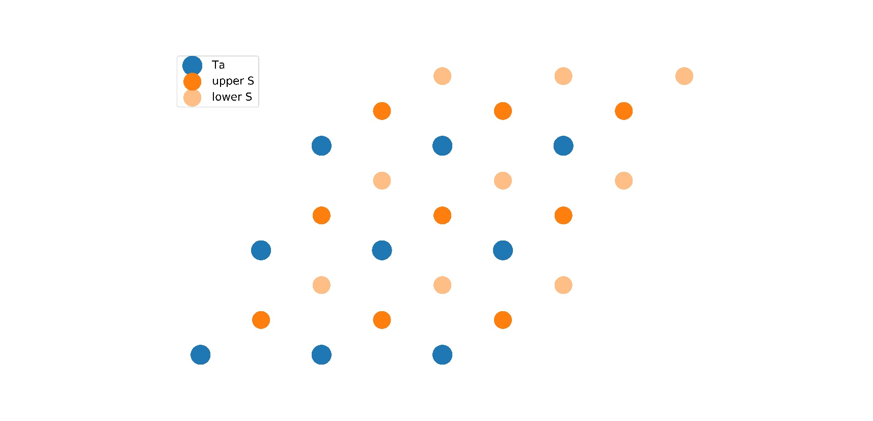
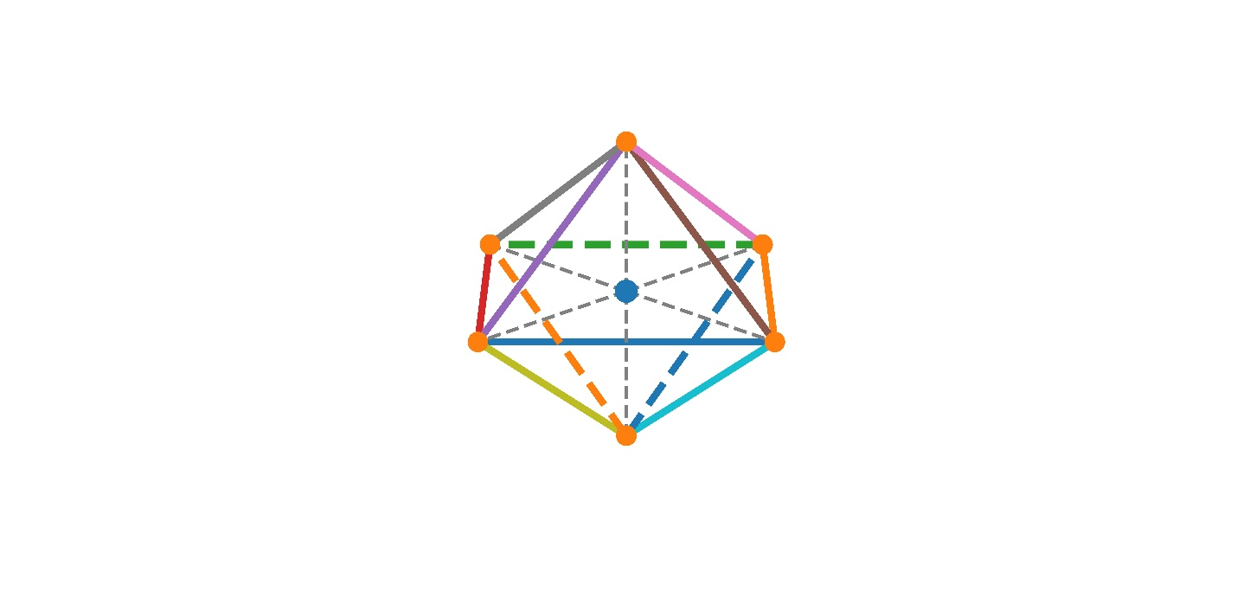
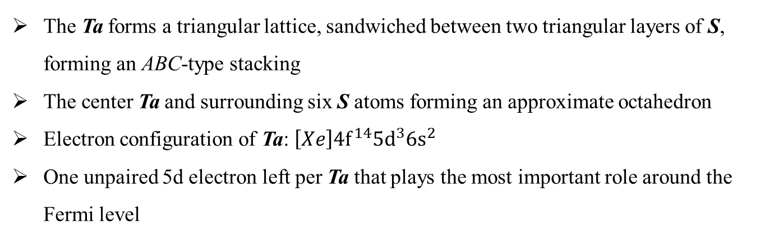
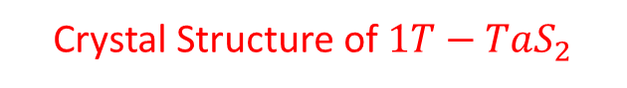
Crystal Structure of $1T−TaS_{2}$
The Ta forms a triangular lattice, sandwiched between two triangular layers of S, forming an ABC-type stacking
The center Ta and surrounding six S atoms forming an approximate octahedron
Electron configuration of Ta: $\left[Xe\right]4f^{14}5d^{3}6s^{2}$
One unpaired 5d electron left per Ta that plays the most important role around the Fermi level

Slide 4
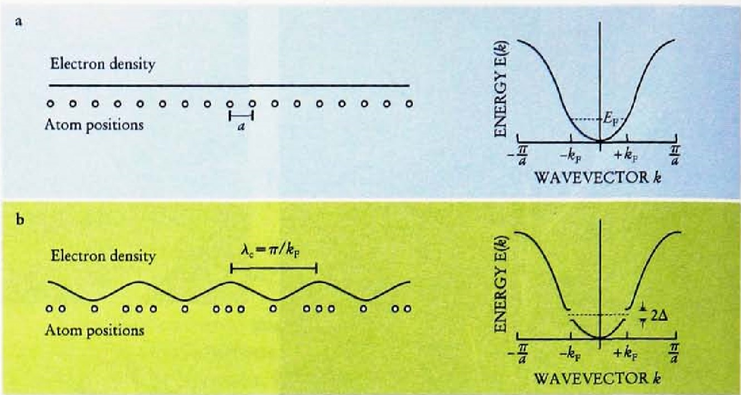
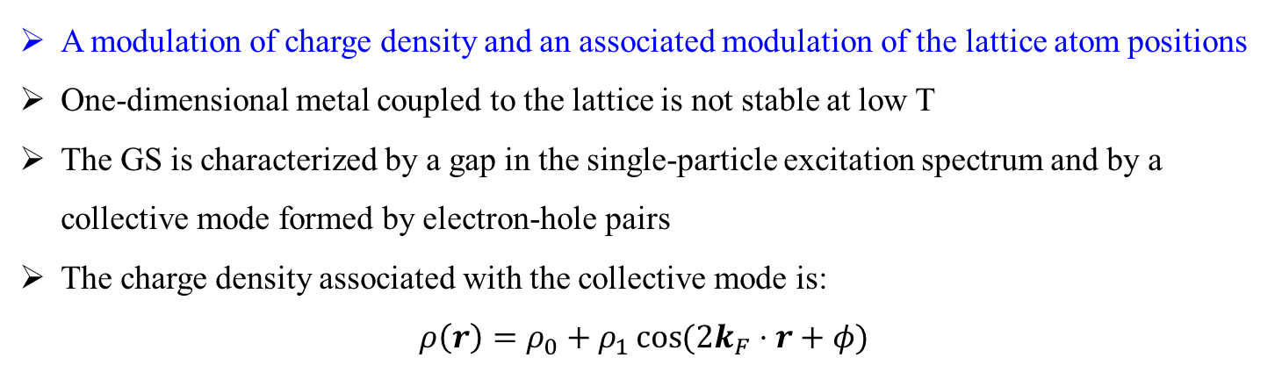
Charge Density Wave
A modulation of charge density and an associated modulation of the lattice atom positions
One-dimensional metal coupled to the lattice is not stable at low T
The GS is characterized by a gap in the single-particle excitation spectrum and by a collective mode formed by electron-hole pairs
The charge density associated with the collective mode is:
$$ρ\left(r\right)=ρ_{0}+ρ_{1}\cos{(2k_{F}⋅r+φ)}$$
Robert E. Thorne, Physics Today 49, 5, 41 (1996)
G. Grüner, Rev. Mod. Phys. 60, 1129 (1988)
R. E. Peierls, Ann. Phys. Leipzig 4, 121 (1930)
Notes:
由于1T-TaS2的相图中涉及好几种CDW相,所以我们这里先对CDW以及相关的Commensurate, Incommensurate的概念做一个简要介绍,当然这些只是基于我自己的理解,可能并不准确严谨
首先,CDW就是电荷密度波的英文缩写.从字面意思来理解, 也就是电荷密度的空间分布受到调制,不再是均匀分布,而是像波一样有的地方高有的地方低.同时这种电荷密度空间分布调制还会伴随着晶格原子的位置变化

Slide 5
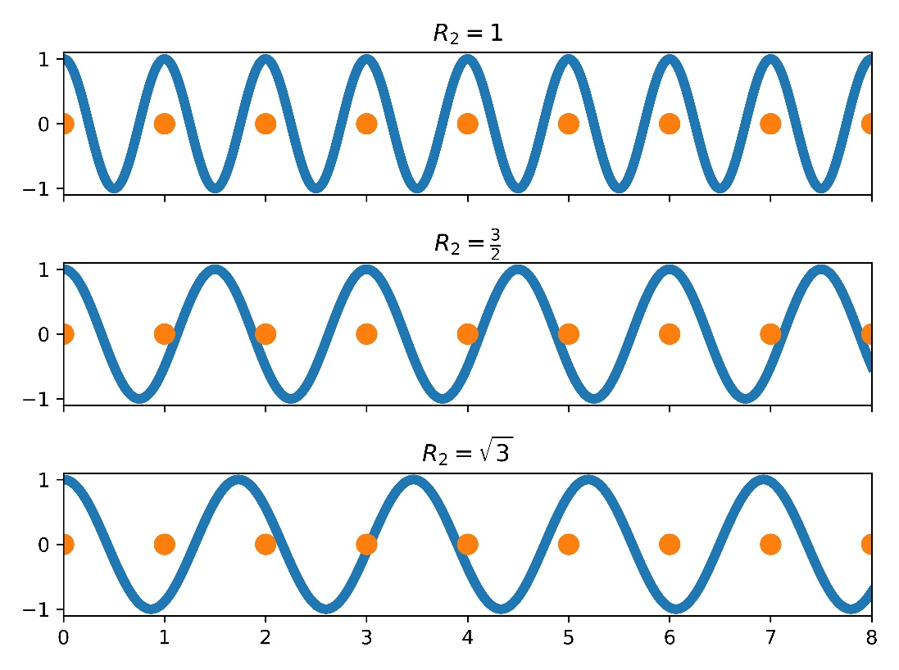
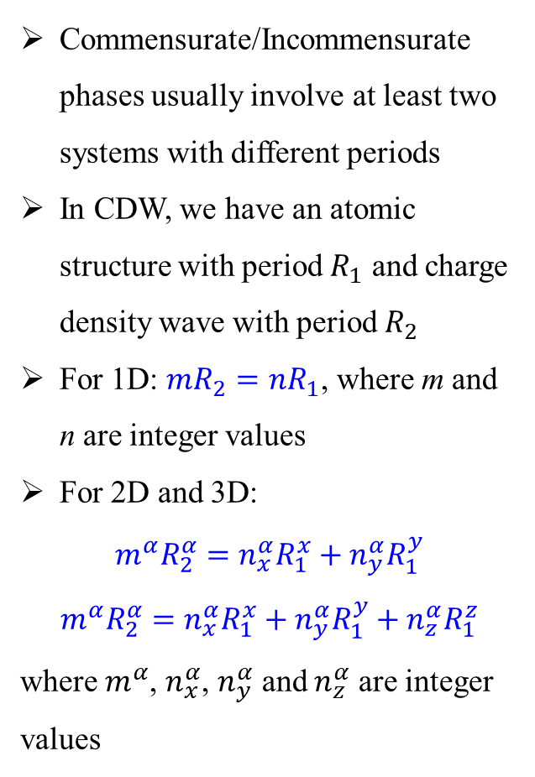
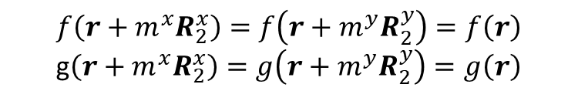
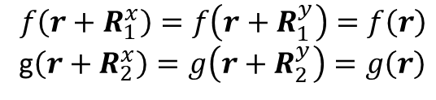
Commensurate and Incommensurate
Commensurate/Incommensurate phases usually involve at least two systems with different periods
In CDW, we have an atomic structure with period $R_{1}$ and charge density wave with period $R_{2}$
For 1D: $mR_{2}=nR_{1}$, where m and n are integer values
For 2D and 3D:
$$m^{α}R_{2}^{α}=n_{x}^{α}R_{1}^{x}+n_{y}^{α}R_{1}^{y}$$
$$m^{α}R_{2}^{α}=n_{x}^{α}R_{1}^{x}+n_{y}^{α}R_{1}^{y}+n_{z}^{α}R_{1}^{z}$$
where $m^{α}$, $n_{x}^{α}$, $n_{y}^{α}$ and $n_{z}^{α}$ are integer values
$$f\left(r+R_{1}^{x}\right)=f\left(r+R_{1}^{y}\right)=f\left(r\right)$$
g$\left(r+R_{2}^{x}\right)=g\left(r+R_{2}^{y}\right)=g\left(r\right)$
$$f\left(r+{m^{x}R}_{2}^{x}\right)=f\left(r+m^{y}R_{2}^{y}\right)=f\left(r\right)$$
g$\left(r+{m^{x}R}_{2}^{x}\right)=g\left(r+m^{y}R_{2}^{y}\right)=g\left(r\right)$

Slide 6
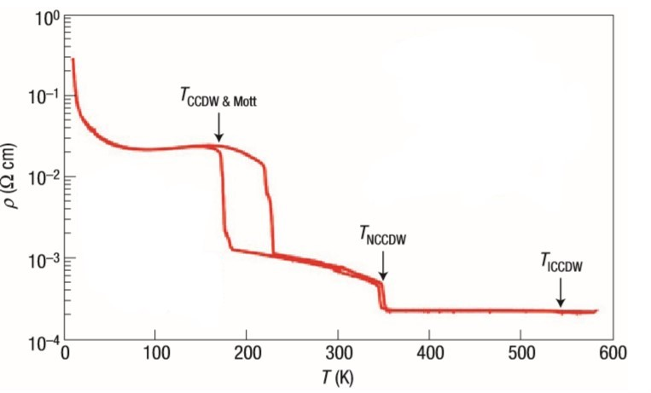
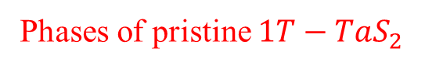
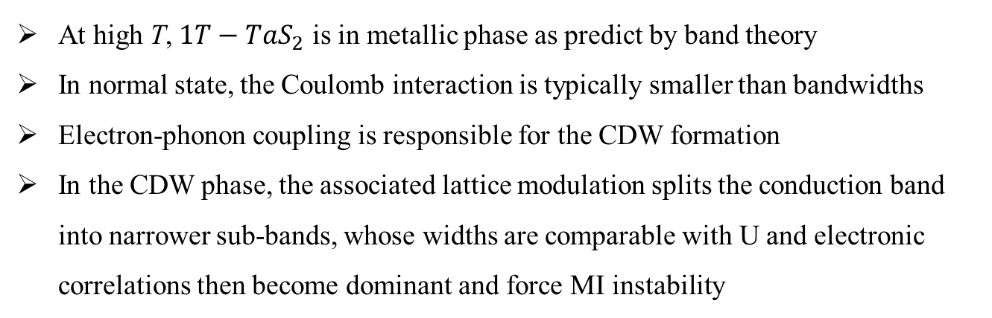
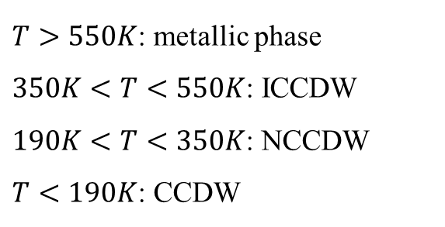
Phases of pristine $1T−TaS_{2}$
$T>550K$: metallic phase
$350K<T<550K$: ICCDW
$190K<T<350K$: NCCDW
$T<190K$: CCDW
At high T, $1T−TaS_{2}$ is in metallic phase as predict by band theory
In normal state, the Coulomb interaction is typically smaller than bandwidths
Electron-phonon coupling is responsible for the CDW formation
In the CDW phase, the associated lattice modulation splits the conduction band into narrower sub-bands, whose widths are comparable with U and electronic correlations then become dominant and force MI instability

Slide 7
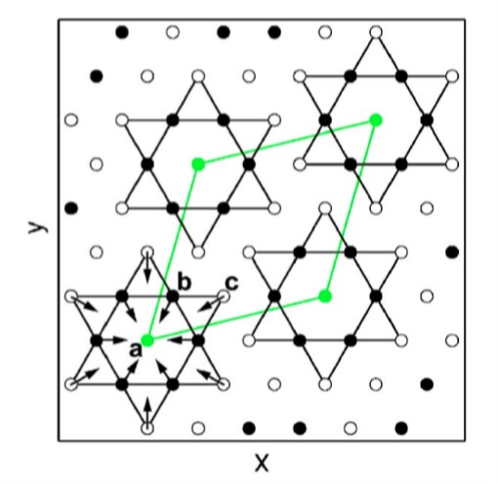
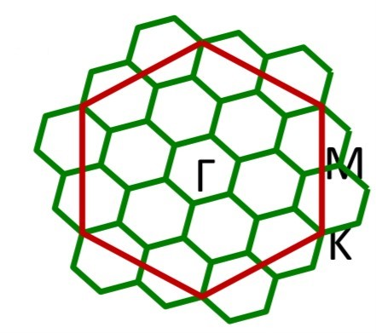
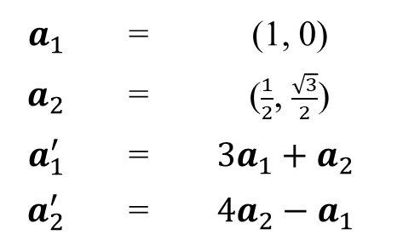
Star of David
$$a_{1}$$ | = | (1, 0)
$$a_{2}$$ | = | ($\frac{1}{2}$, $\frac{\sqrt{3}}{2}$)
$$a_{1}^{′}$$ | = | $$3a_{1}+a_{2}$$
$$a_{2}^{′}$$ | = | $$4a_{2}−a_{1}$$
There are three inequivalent types of Ta atoms in the unit cell designated as “a”, “b”, “c”.
The ab and bc interatomic distances shrink by 6.4 %and 3.2% respectively

Slide 8
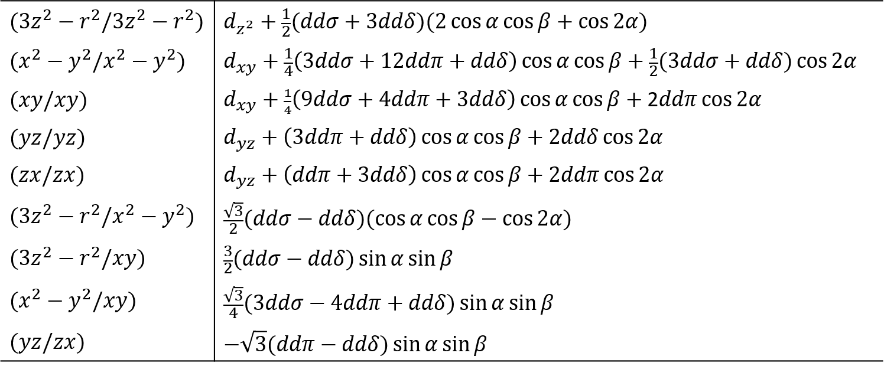
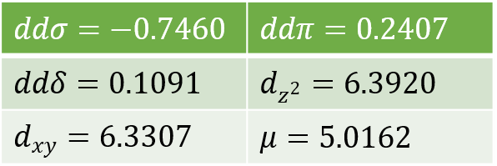
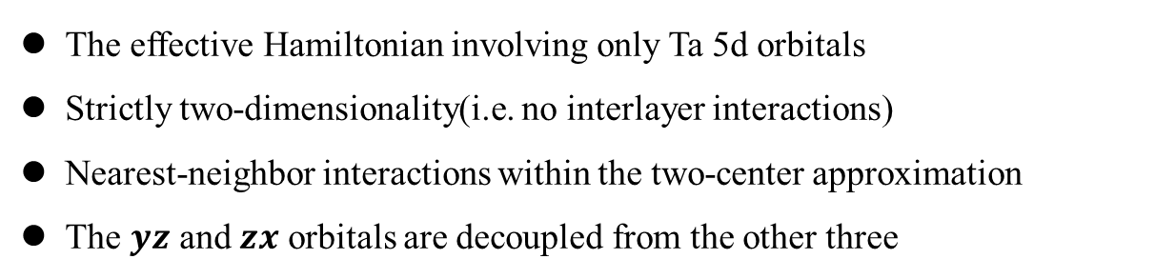
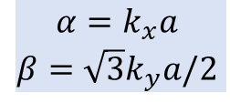
Empirical tight-binding for unreconstructed
N. V. Smith et al., J. Phys. C: Solid State Phys. 18, 3175 (1985)
The effective Hamiltonian involving only Ta 5d orbitals
Strictly two-dimensionality(i.e. no interlayer interactions)
Nearest-neighbor interactions within the two-center approximation
The $yz$ and $zx$ orbitals are decoupled from the other three
$$α=k_{x}a$$
$$β=\sqrt{3}k_{y}a/2$$

Slide 9
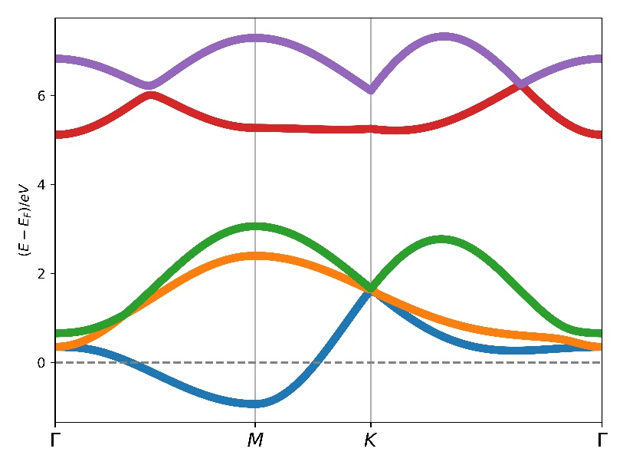
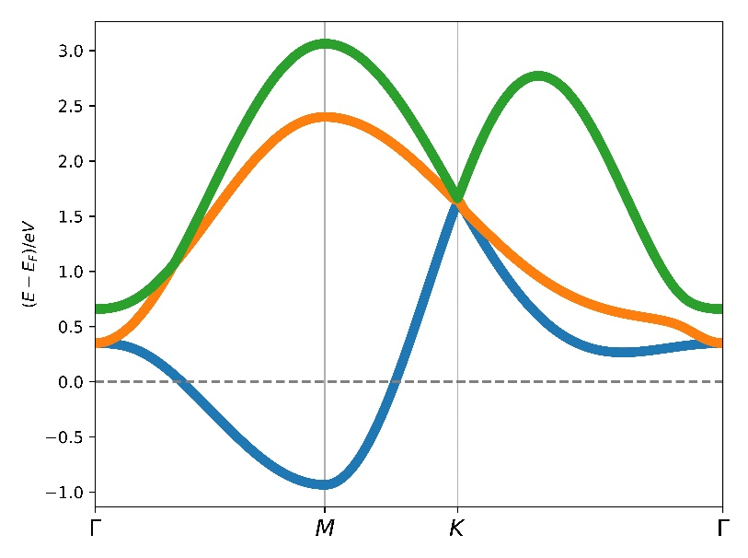
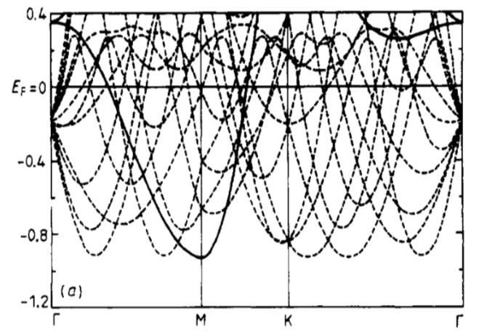
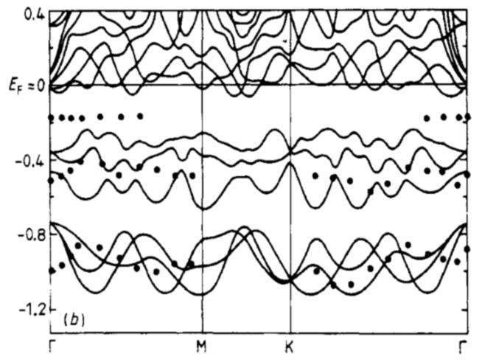
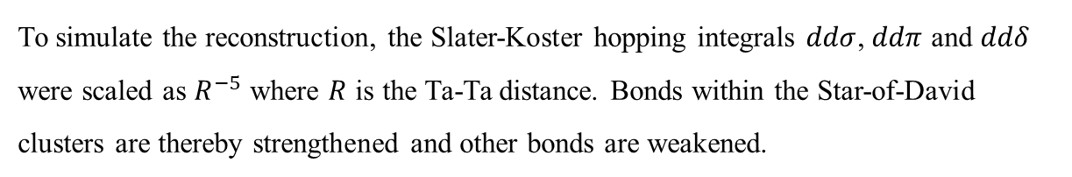
To simulate the reconstruction, the Slater-Koster hopping integrals $ddσ$, $ddπ$ and $ddδ$ were scaled as $R^{−5}$ where $R$ is the Ta-Ta distance. Bonds within the Star-of-David clusters are thereby strengthened and other bonds are weakened.

Slide 10
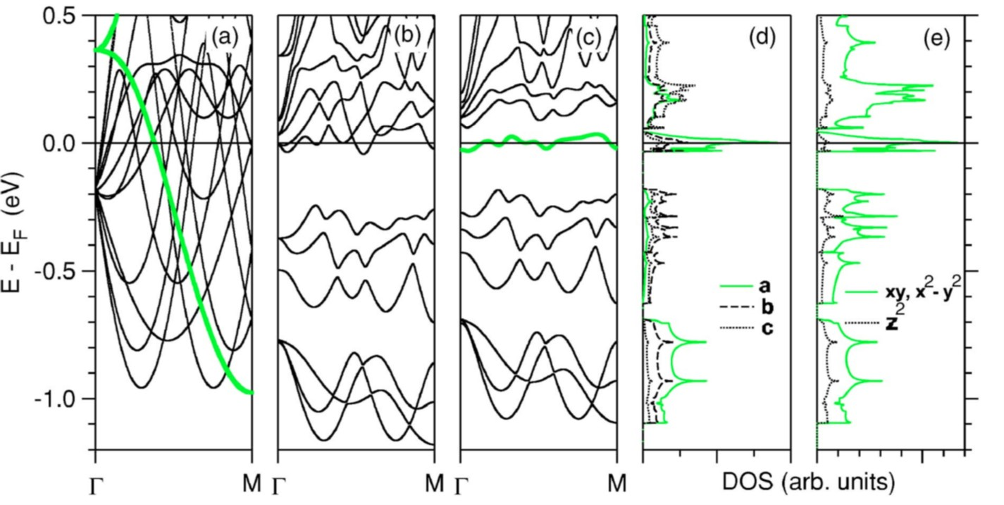
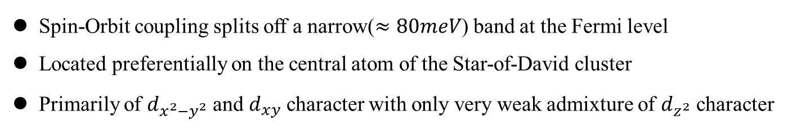
K. Rossnagel, N. V. Smith, Phys. Rev. B 73, 073106 (2006)
Spin-Orbit coupling splits off a narrow($≈80meV$) band at the Fermi level
Located preferentially on the central atom of the Star-of-David cluster
Primarily of $d_{x^{2}−y^{2}}$ and $d_{xy}$ character with only very weak admixture of $d_{z^{2}}$ character

Slide 11
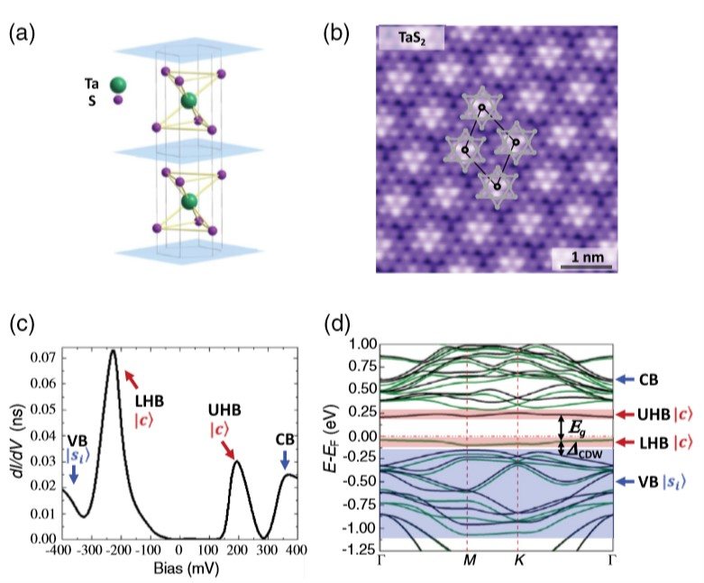
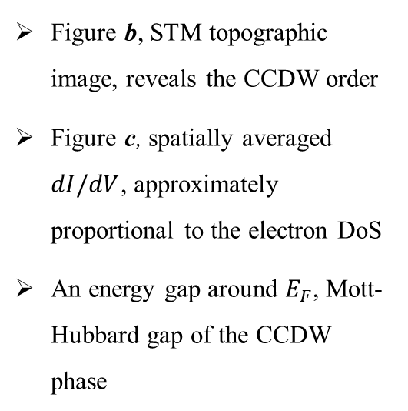
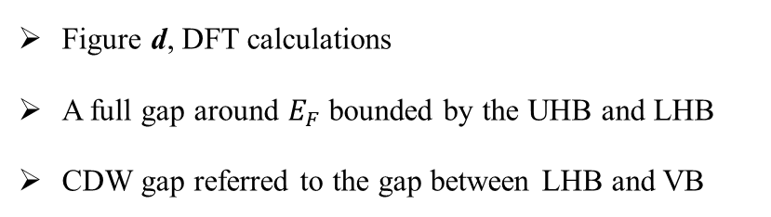
Figure b, STM topographic image, reveals the CCDW order
Figure c, spatially averaged $dI/dV$, approximately proportional to the electron DoS
An energy gap around $E_{F}$, Mott-Hubbard gap of the CCDW phase
Figure d, DFT calculations
A full gap around $E_{F}$ bounded by the UHB and LHB
CDW gap referred to the gap between LHB and VB
Shuang Qiao et al.,
Phys. Rev. X 7, 041054 (2017)

Slide 12
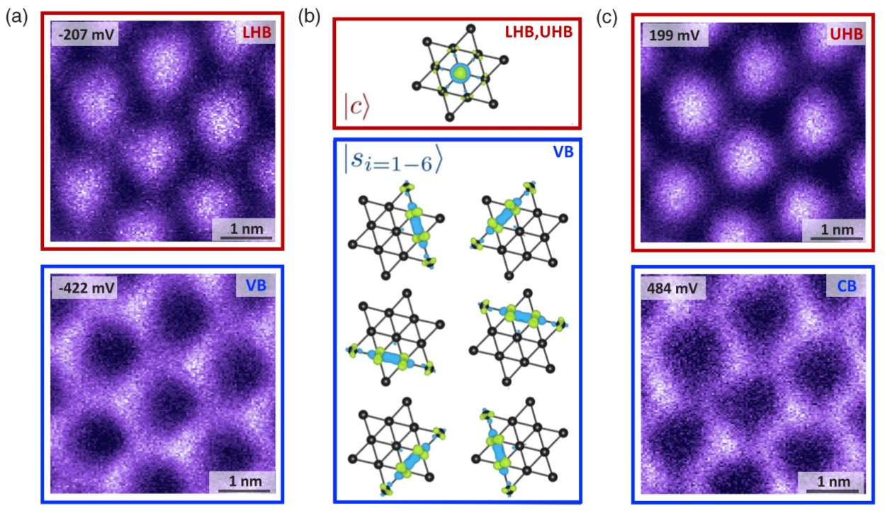
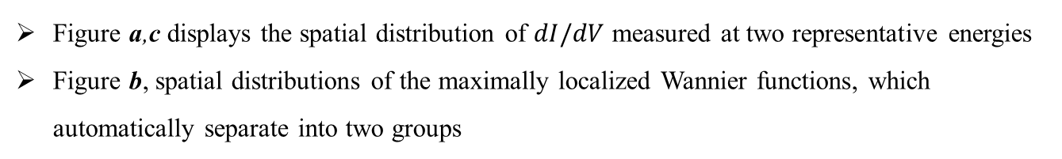
Figure a,c displays the spatial distribution of $dI/dV$ measured at two representative energies
Figure b, spatial distributions of the maximally localized Wannier functions, which automatically separate into two groups

Slide 13
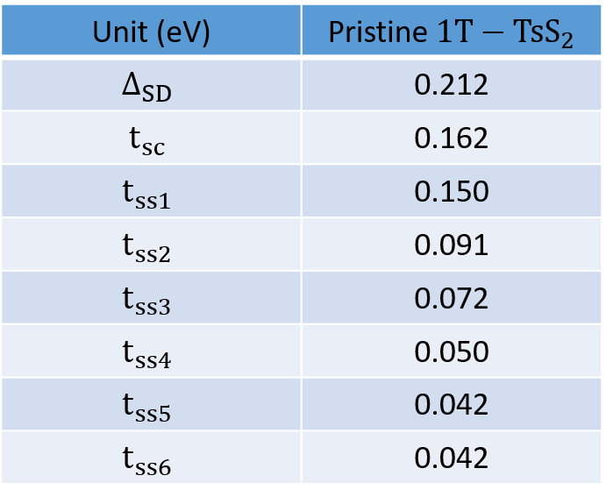
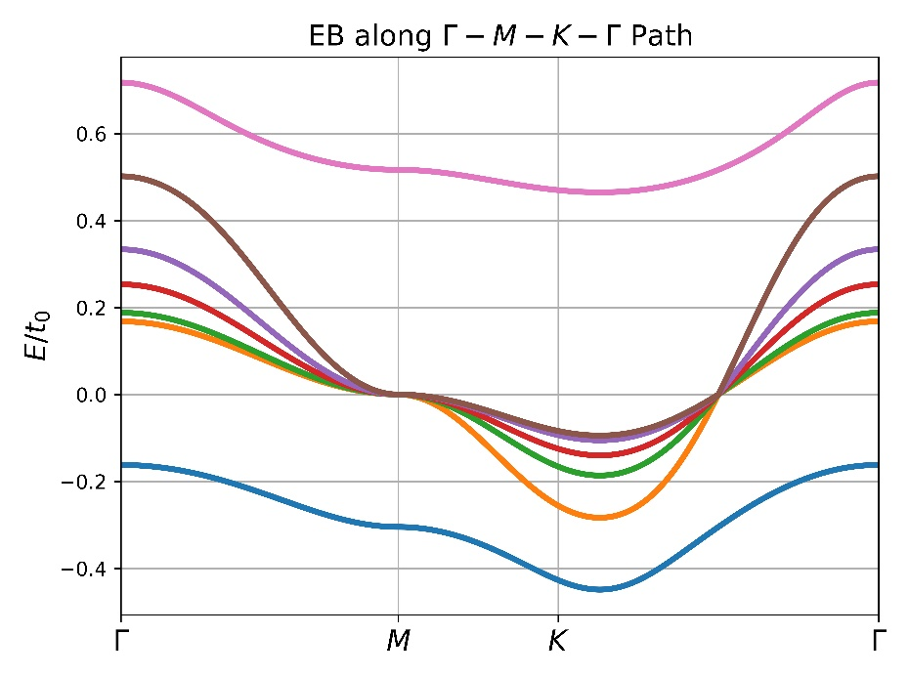
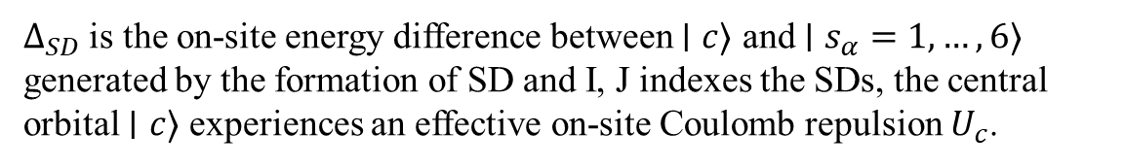
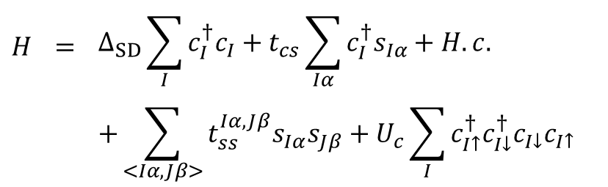
$$H$$ | $$=$$ | $$Δ_{SD}\sum_{I}{c_{I}^{†}c_{I}}+t_{cs}\sum_{Iα}{c_{I}^{†}s_{Iα}+H.c.}$$
 |  | $$+\sum_{<Iα,Jβ>}{t_{ss}^{Iα,Jβ}s_{Iα}s_{Jβ}}+U_{c}\sum_{I}{c_{I↑}^{†}c_{I↓}^{†}c_{I↓}c_{I↑}}$$
$Δ_{SD}$ is the on-site energy difference between $∣c⟩$ and $∣s_{α}=1, …, 6⟩$ generated by the formation of SD and I, J indexes the SDs, the central orbital $∣c⟩$ experiences an effective on-site Coulomb repulsion $U_{c}$.

Slide 14
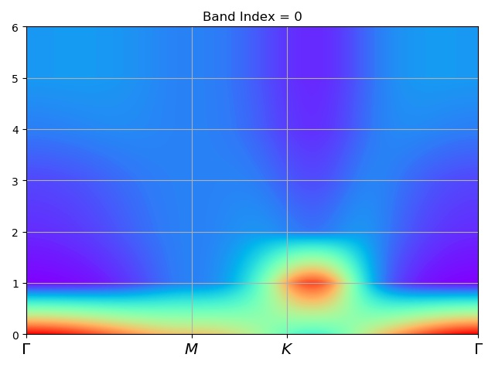
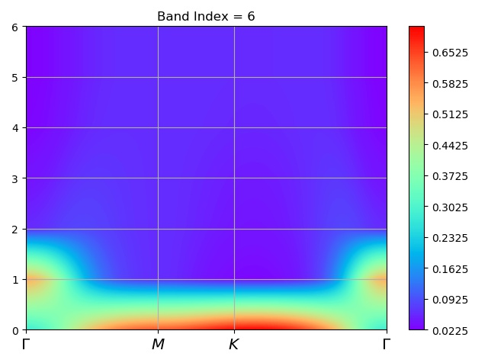
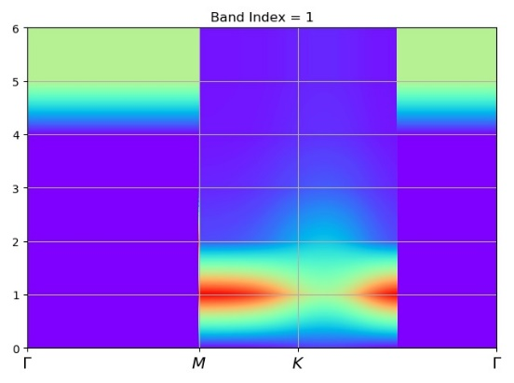
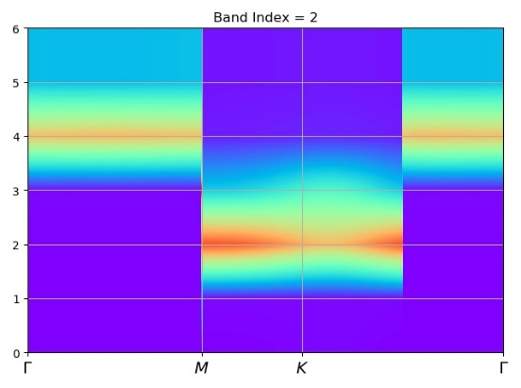
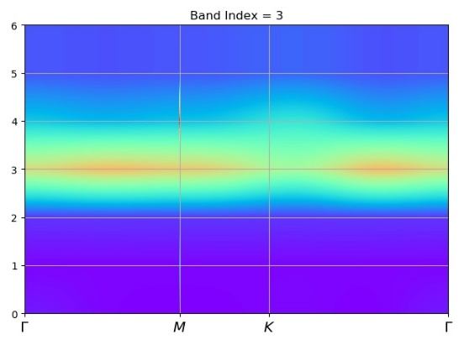
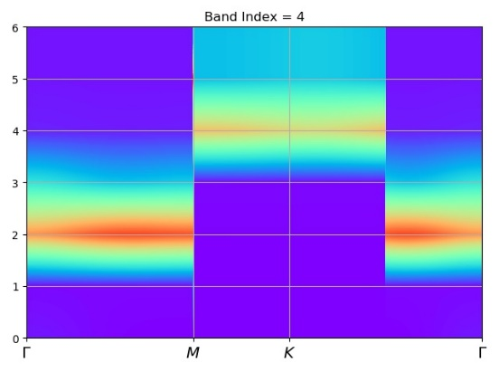
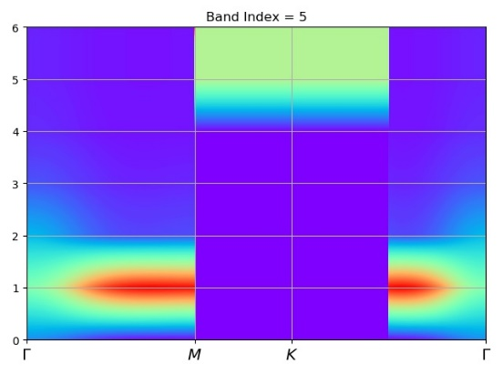
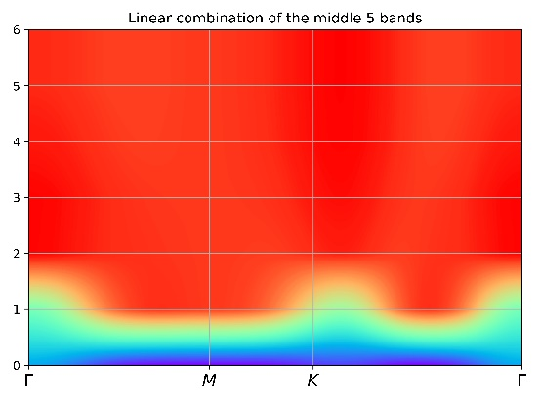

Slide 16
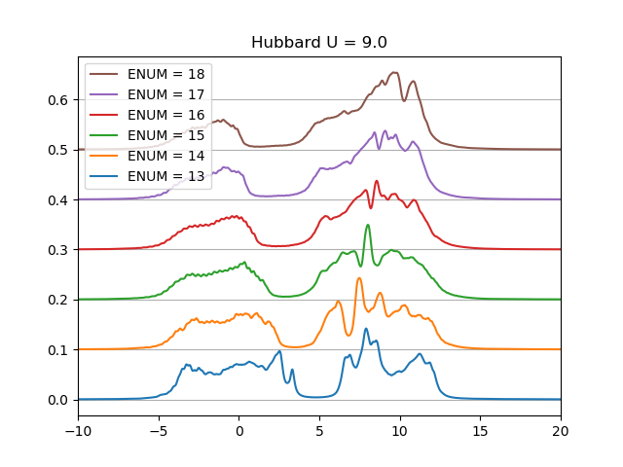



$$H=−t\sum_{<ij>α}{c_{iα}^{†}c_{jα}+H.c.}+U\sum_{i}{n_{i↑}n_{i↓}}$$

Slide 17


$$H$$ | $$=$$ | $$H_{t}+\sum_{iα}{μ_{i}c_{iα}^{†}c_{iα}}+U\sum_{i}{n_{i↑}n_{i↓}}$$
$$H_{t}$$ | $$=$$ | $$−t_{0}\sum_{\begin{aligned}I,α \\ type0\end{aligned}}{c_{Iα}^{†}c_{Iα}}−t_{1}\sum_{\begin{aligned}I,α \\ type1\end{aligned}}{c_{Iα}^{†}c_{Iα}}−t_{2}\sum_{\begin{aligned}<I,J>α \\ type2\end{aligned}}{c_{Iα}^{†}c_{Jβ}}−t_{3}\sum_{\begin{aligned}<I,J>α \\ type3\end{aligned}}{c_{Iα}^{†}c_{Jβ}}+H.c.$$

Slide 18





$$\left\langle n_{a}\right\rangle =0.9745$$
$$\left\langle n_{b}\right\rangle =0.8320$$
$$\left\langle n_{c}\right\rangle =1.1723$$

Slide 19






$μ=0.5$ for type A Ta
$μ=−0.5$ for type B and C Ta
$\left\langle n_{a}\right\rangle =0.$4157
$\left\langle n_{b}\right\rangle =0.86$57
$\left\langle n_{c}\right\rangle =1.2$317

Slide 20
Thank you!

